Slide 1
Sentiment Analytics for Streaming Platform User Experience Uncovering User Sentiment Patterns in Disney+ Application Reviews
Group 10086
Du Qinshi, Zhao Wei, Gao Xinran, Jiang Yihu, Zheng Yiyang

Slide 2
01 Research Identification
02 Data ​Pre-processing
Content
03 Descriptive analysis
04 Sentiment Analysis
05 Emotion Analysis
06 Clustering & KNN
07 Conclusion

Slide 3
01
Research Identification
1. Background
2. Questions and Hypotheses

Slide 4
Background
Disney+, launched in November 2019, is Walt Disney Company's subscription-based streaming service that offers content from Disney, Pixar, Marvel, Star Wars, National Geographic, and more.
This project analyzes user sentiment toward the Disney+ streaming application through comprehensive examination of user reviews. By collecting and analyzing about 5000 reviews from app stores, our team aimed to understand user satisfaction levels, identify key pain points, and provide actionable recommendations for improving the user experience.

Slide 5
Research Questions and Hypotheses
Question: How has user sentiment toward Disney+ evolved over time and across different versions?
Hypothesis (H1): User satisfaction with Disney+ has improved since its launch, with each major update showing progressively higher ratings.
Question 1
Question 2
Question: What main factors drive negative reviews of the Disney+ app?
Hypothesis (H2): Technical issues (app functionality, streaming quality) and advertising complaints are the primary sources of dissatisfaction, with varying importance across versions.
Question 3
Question: Can machine learning effectively predict user satisfaction from review content?
Hypothesis (H3): Neural Networks can predict ratings with over 80% accuracy, with emotional language and technical terms being the strongest predictors.
Question 4
Question: How do different emotions in reviews relate to overall ratings?
Hypothesis (H4): Negative emotions (anger, disgust, fear) strongly correlate with lower ratings, while positive emotions (joy, anticipation) correlate with higher ratings.

Slide 6
02
Data ​ Pre-processing​

Slide 7
Data Pre-processing
Data Source
The data was collected through a custom web scraping process targeting the Disney+ application's review pages on Google Play. The scraping was performed using Python-based tools that collected each review's rating, text content, submission date, app version, and reply information.
Data Cleaning Process
Column Removal: Eliminated irrelevant columns), including: reviewId, userName, userImage, reviewCreatedVersion, game_id
Null Value Handling: Removed 392 rows with null values in the appVersion column
Emoji Removal: Eliminated emoji characters from all review content to prevent encoding issues and ensure text consistency
Text Cleaning: Removed special characters from content and replyContent fields, preserving only basic punctuation
Text Standardization: Converted all text to lowercase for consistent analysis
Feature Engineering: Created metrics including review length and sentiment scores to enhance analytical capabilities
Format Standardization: Normalized date formats and version numbers to enable temporal and version-based analysis

Slide 8
03
Descriptive analysis​

Slide 9
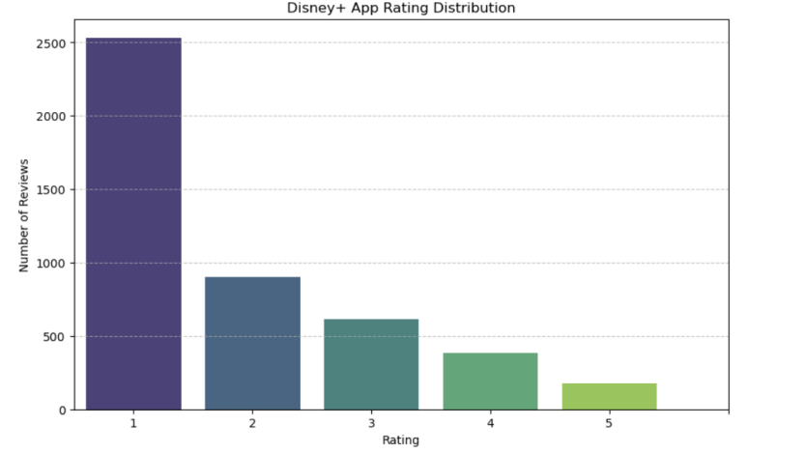
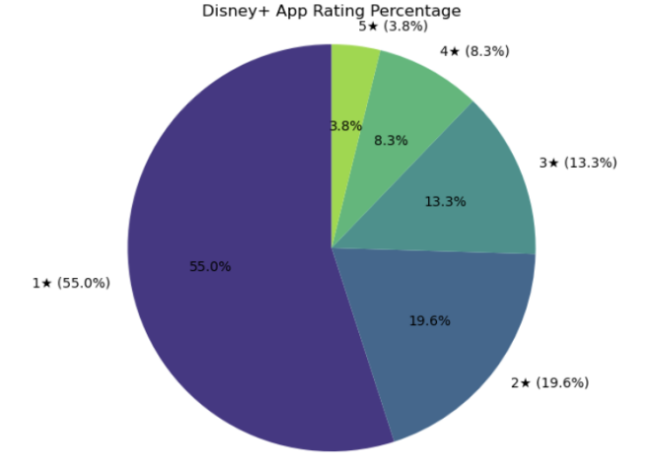
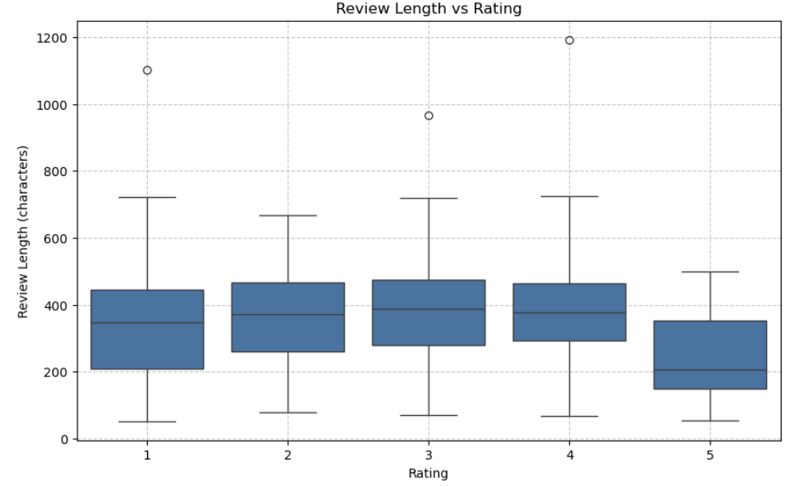
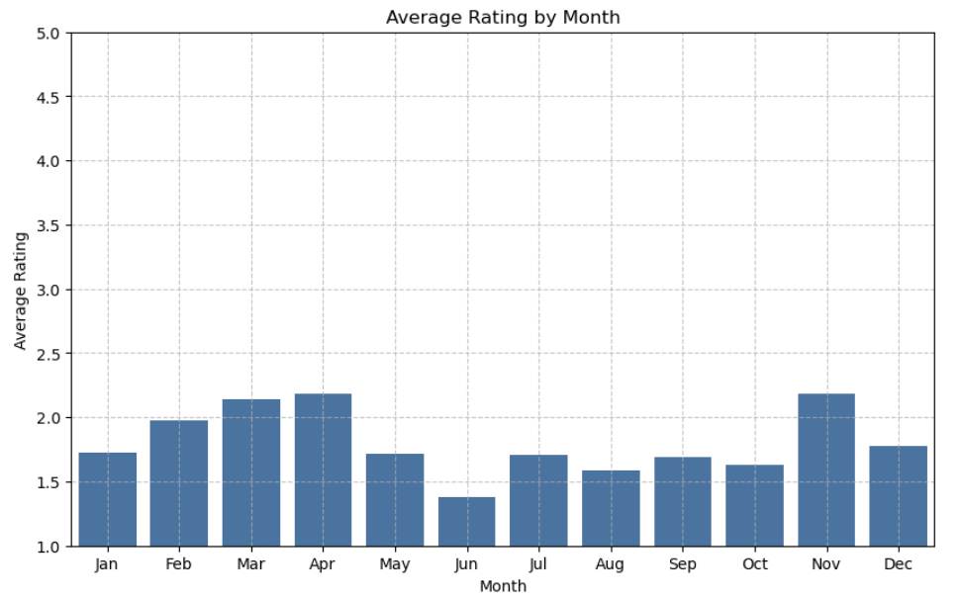
Descriptive analysis
Rating Distribution: User ratings for the Disney+ app show overwhelming dissatisfaction. More than half (55%) of users gave the lowest possible 1-star rating. Only 12% of users expressed satisfaction with 4-5 star ratings. This distribution clearly demonstrates widespread user disappointment with the application.
Review Length Analysis: Reviews reveal that dissatisfied users write significantly longer feedback (350-400 characters) than satisfied users.
Seasonality Analysis: Disney+ ratings show seasonal patterns with higher satisfaction in spring and fall.

Slide 10
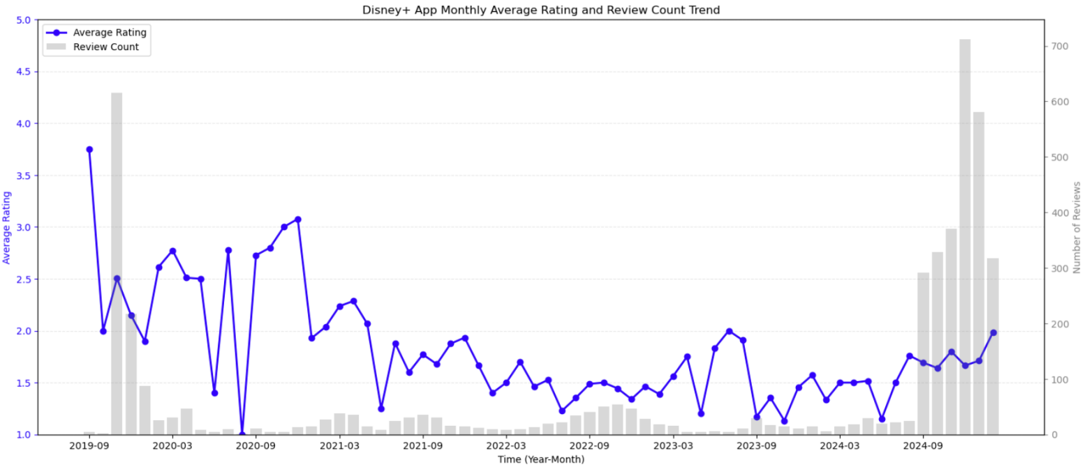
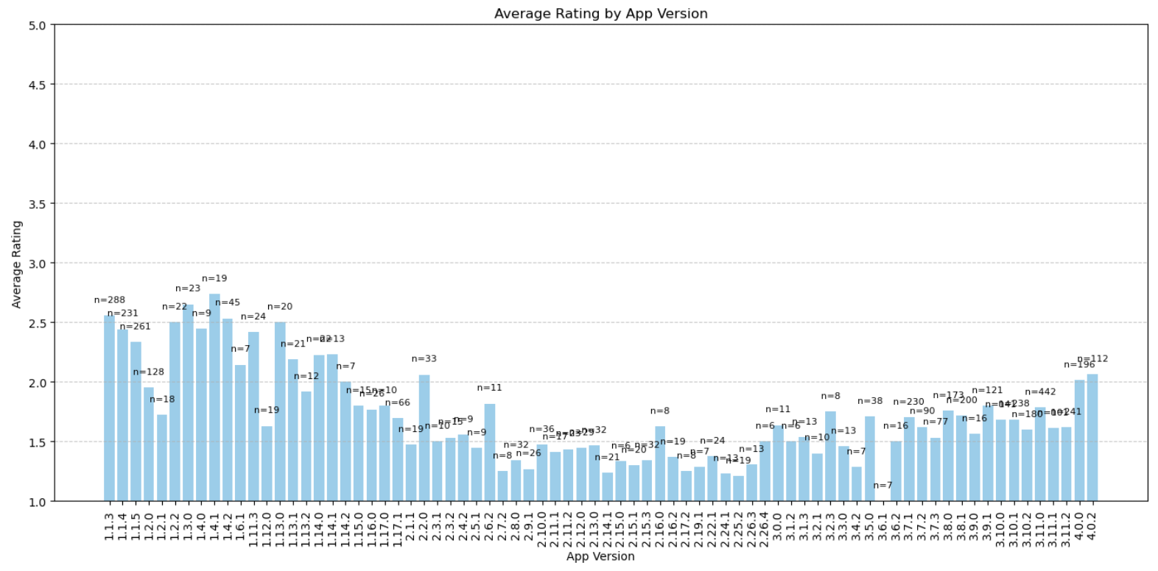
Descriptive analysis
Rating Trends Over Time: Disney+ ratings have steadily declined from 3.8 stars at launch in 2019 to approximately 1.5 stars in 2022-2023. Despite five years of development, ratings consistently remained below 3 stars, with a sharp increase in negative reviews in late 2024 indicating intensifying user dissatisfaction. This persistent downward trend suggests fundamental issues remain unresolved.
App Version Analysis: Disney+ app ratings declined significantly across versions, with early 1.x releases averaging around 2.5 stars before dropping sharply to approximately 1.5 stars during the 2.x series. More recent 3.x and 4.x versions failed to reverse this trend, consistently remaining below 2.0 stars despite continued development.

Slide 11
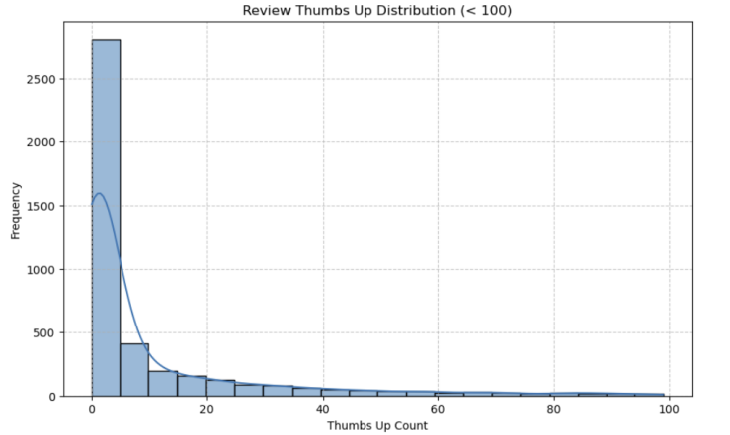
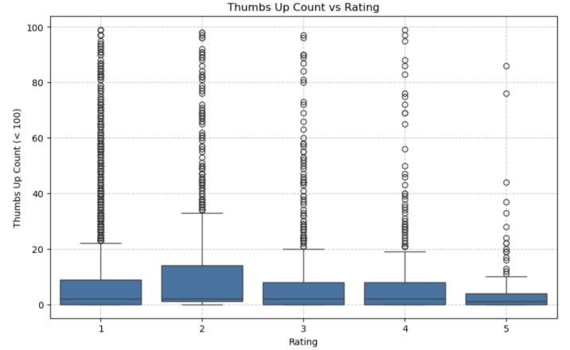
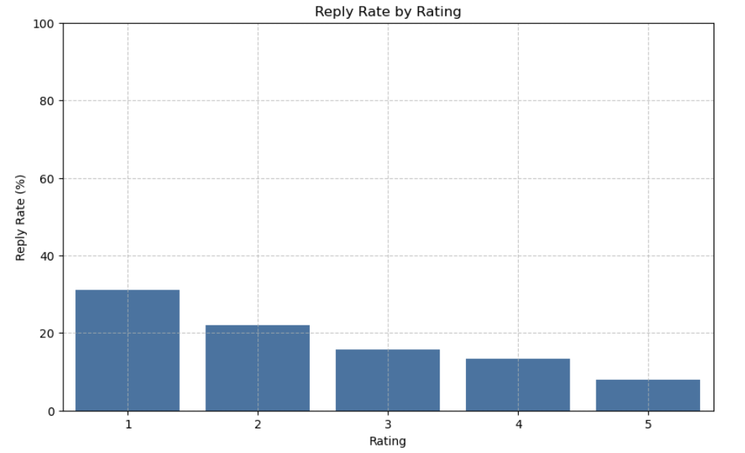
Descriptive analysis
Thumbs Up Analysis: Most Disney+ app reviews receive minimal user engagement, with the vast majority garnering fewer than 10 "thumbs up" votes.
Reply Analysis: Disney+ demonstrates a strategic prioritization in customer service, responding to approximately 30% of 1-star reviews while addressing only about 7% of 5-star feedback. This pattern reveals the company prioritizes addressing negative feedback rather than acknowledging positive user experiences.

Slide 12
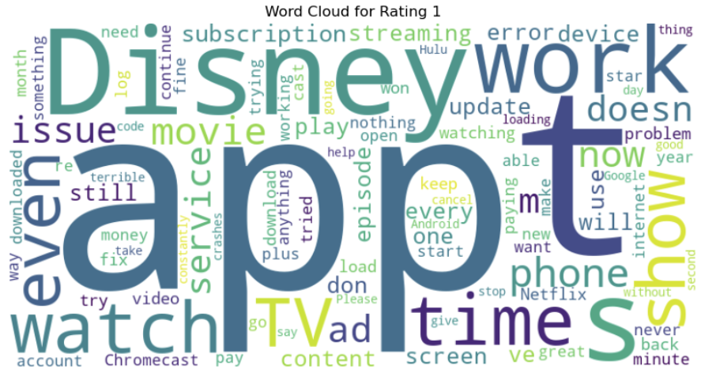
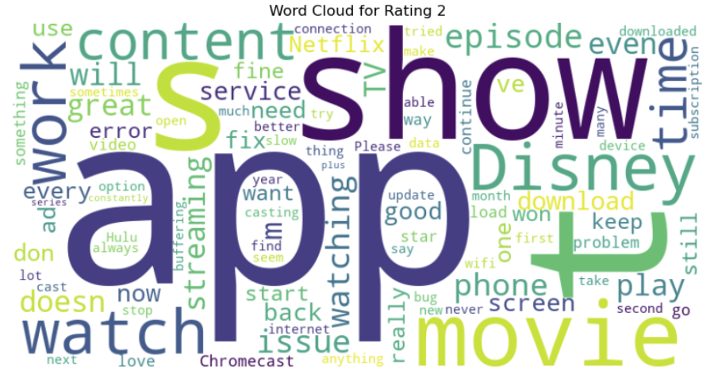
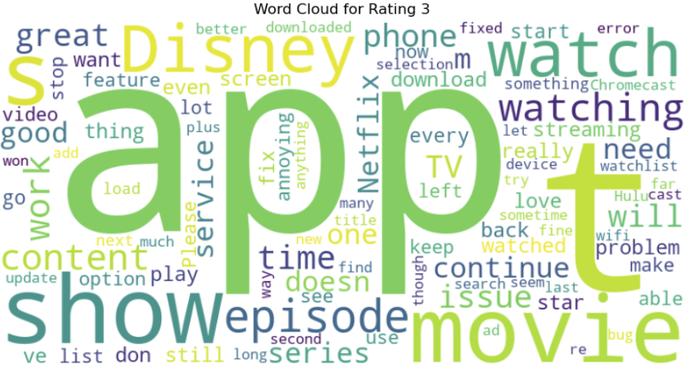
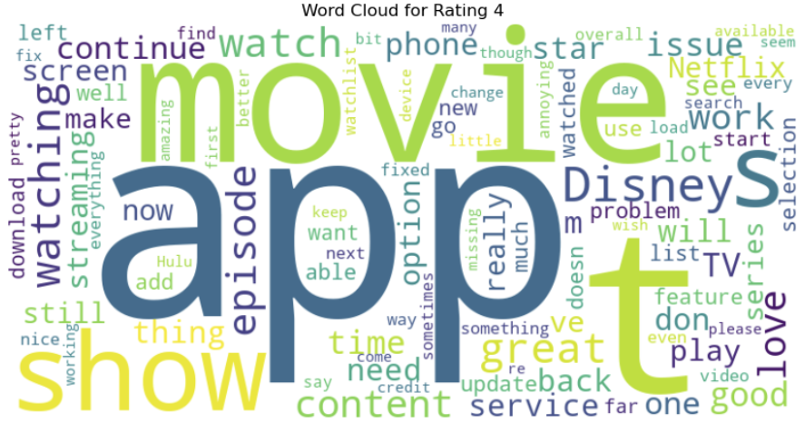
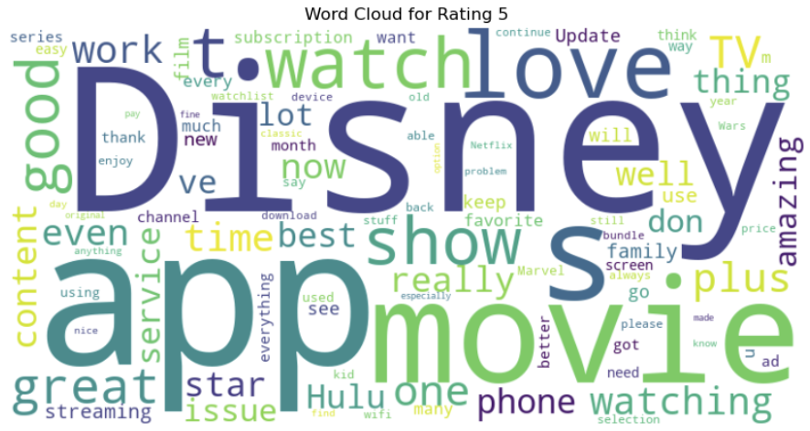
Descriptive analysis
Review Content Text Analysis: Disney+ reviews show clear rating-based patterns: 1-star reviews primarily discuss technical failures with phrases like "doesn't work" and "issue"; 2-3 star reviews focus more on content concerns mentioning "show," "movie," and "episode"; while 4-5 star reviews use positive emotional language like "love" and "great" with minimal technical terminology.

Slide 13
04
Sentiment Analysis
1. VADER Sentiment Analysis
2. App Version Word Analysis

Slide 14
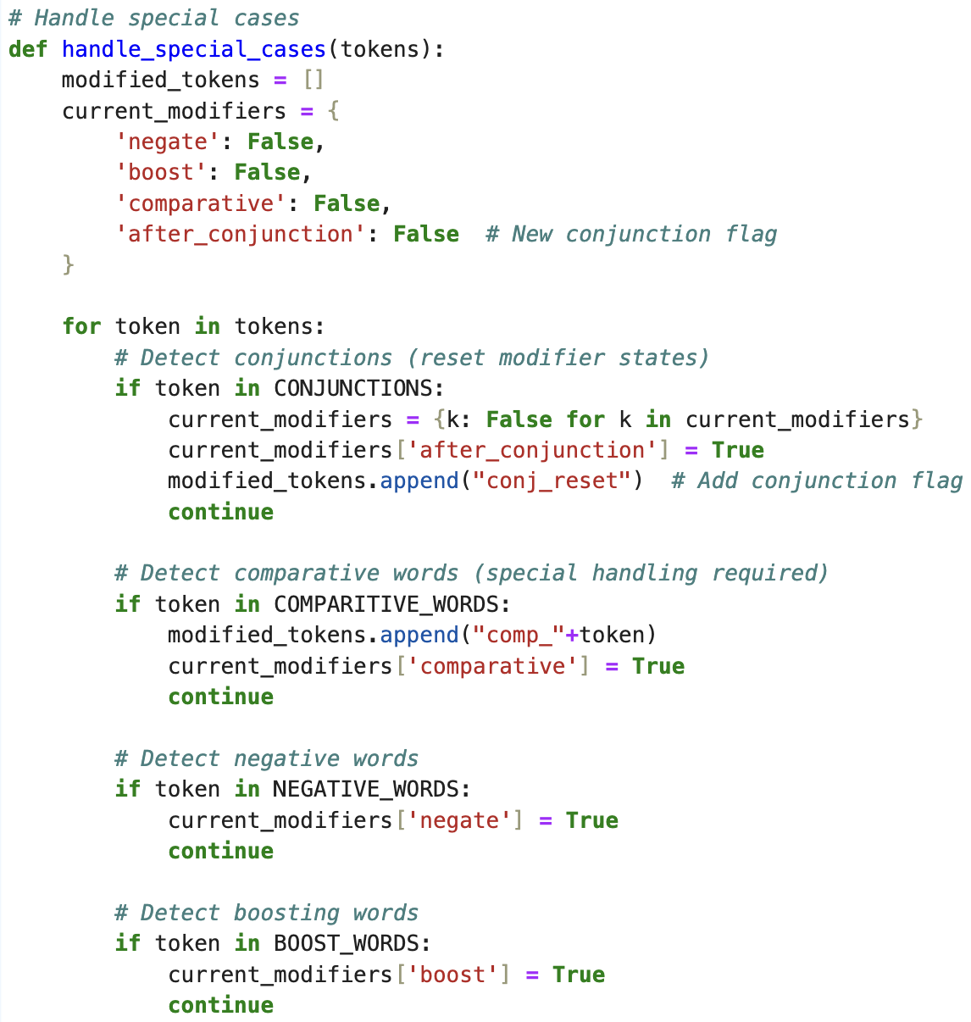
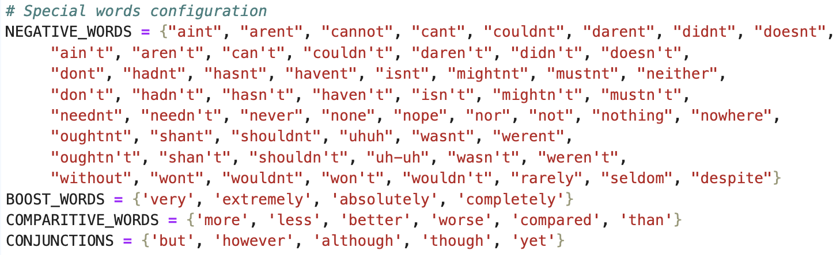
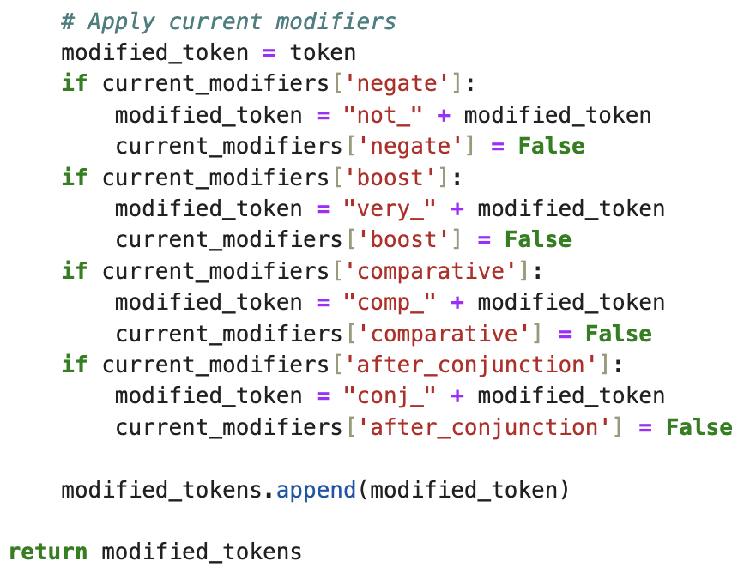
VADER Sentiment Analysis
Special Words
Negative Words: reverse the sentiment
Boost Words: amplify the sentiment
Comparative Words: modify the sentiment to reflect comparisons
Conjunctions (adversative): reset sentiment modifiers

Slide 15
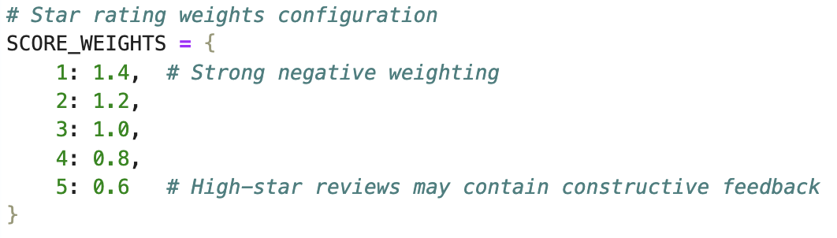
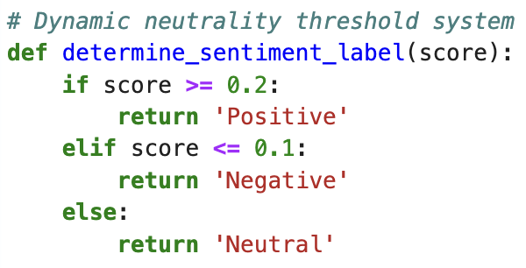
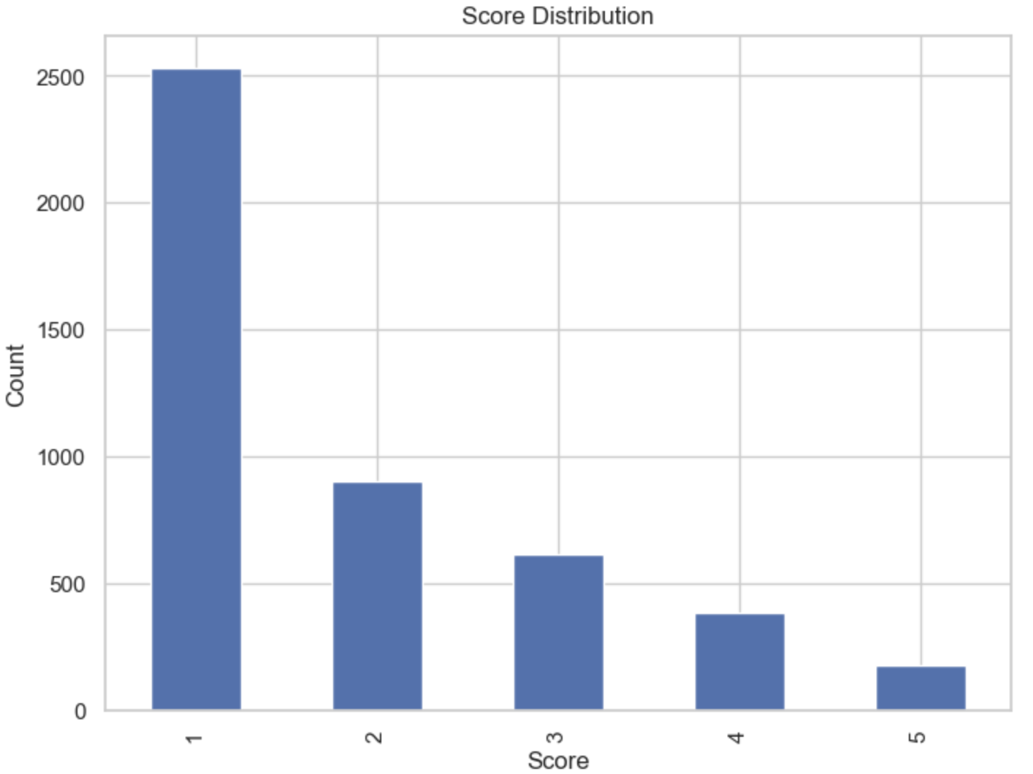
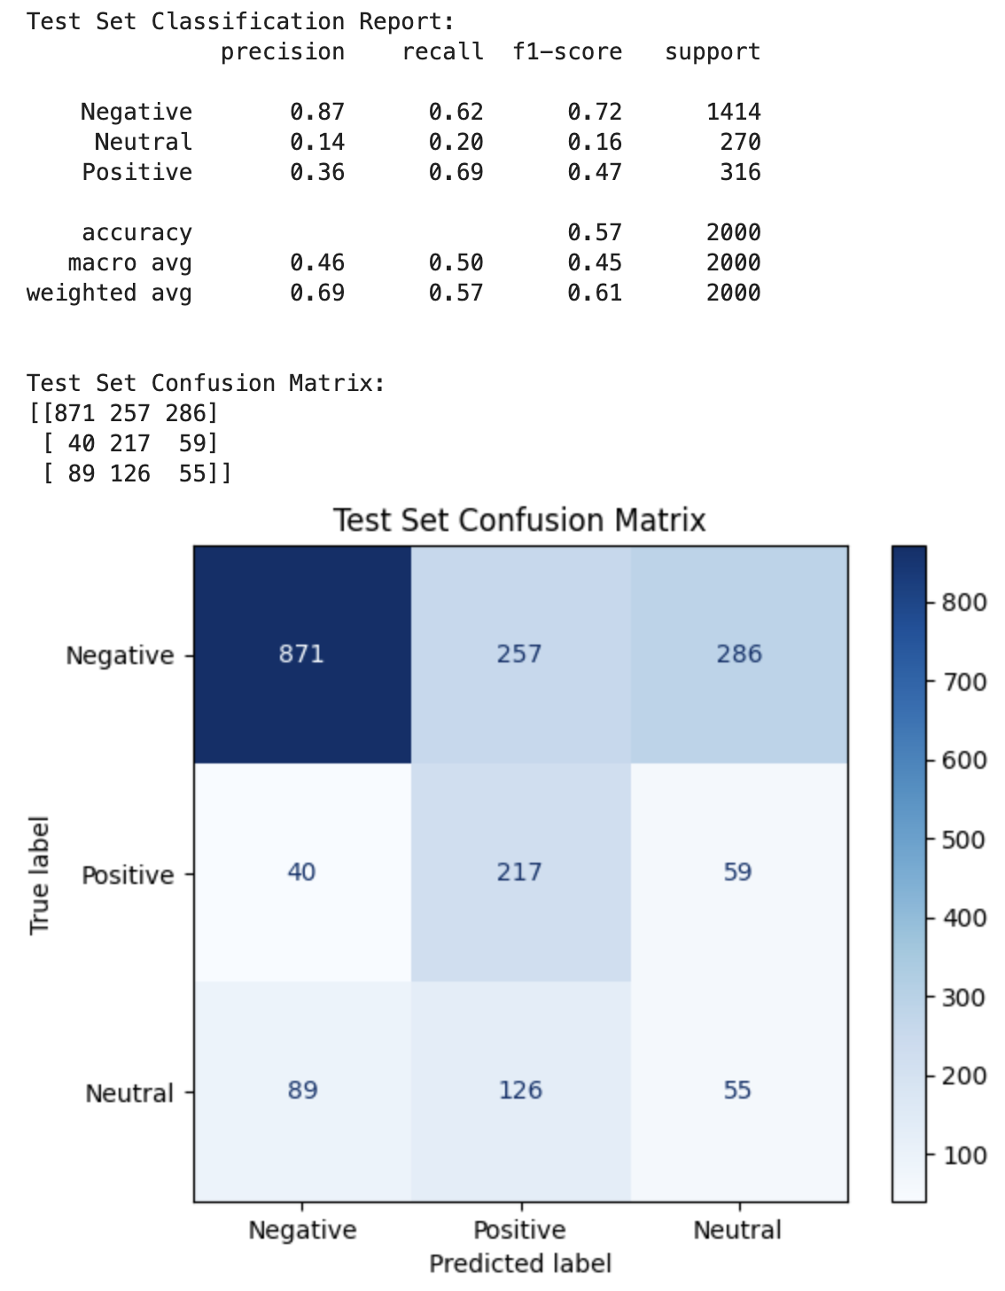
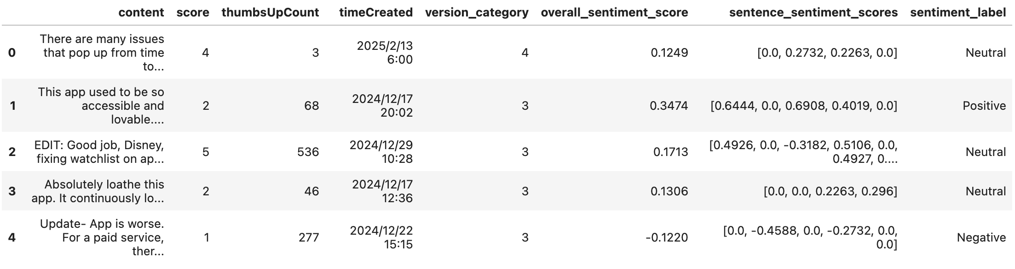
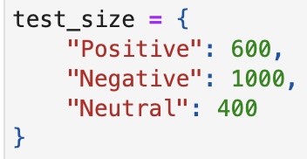
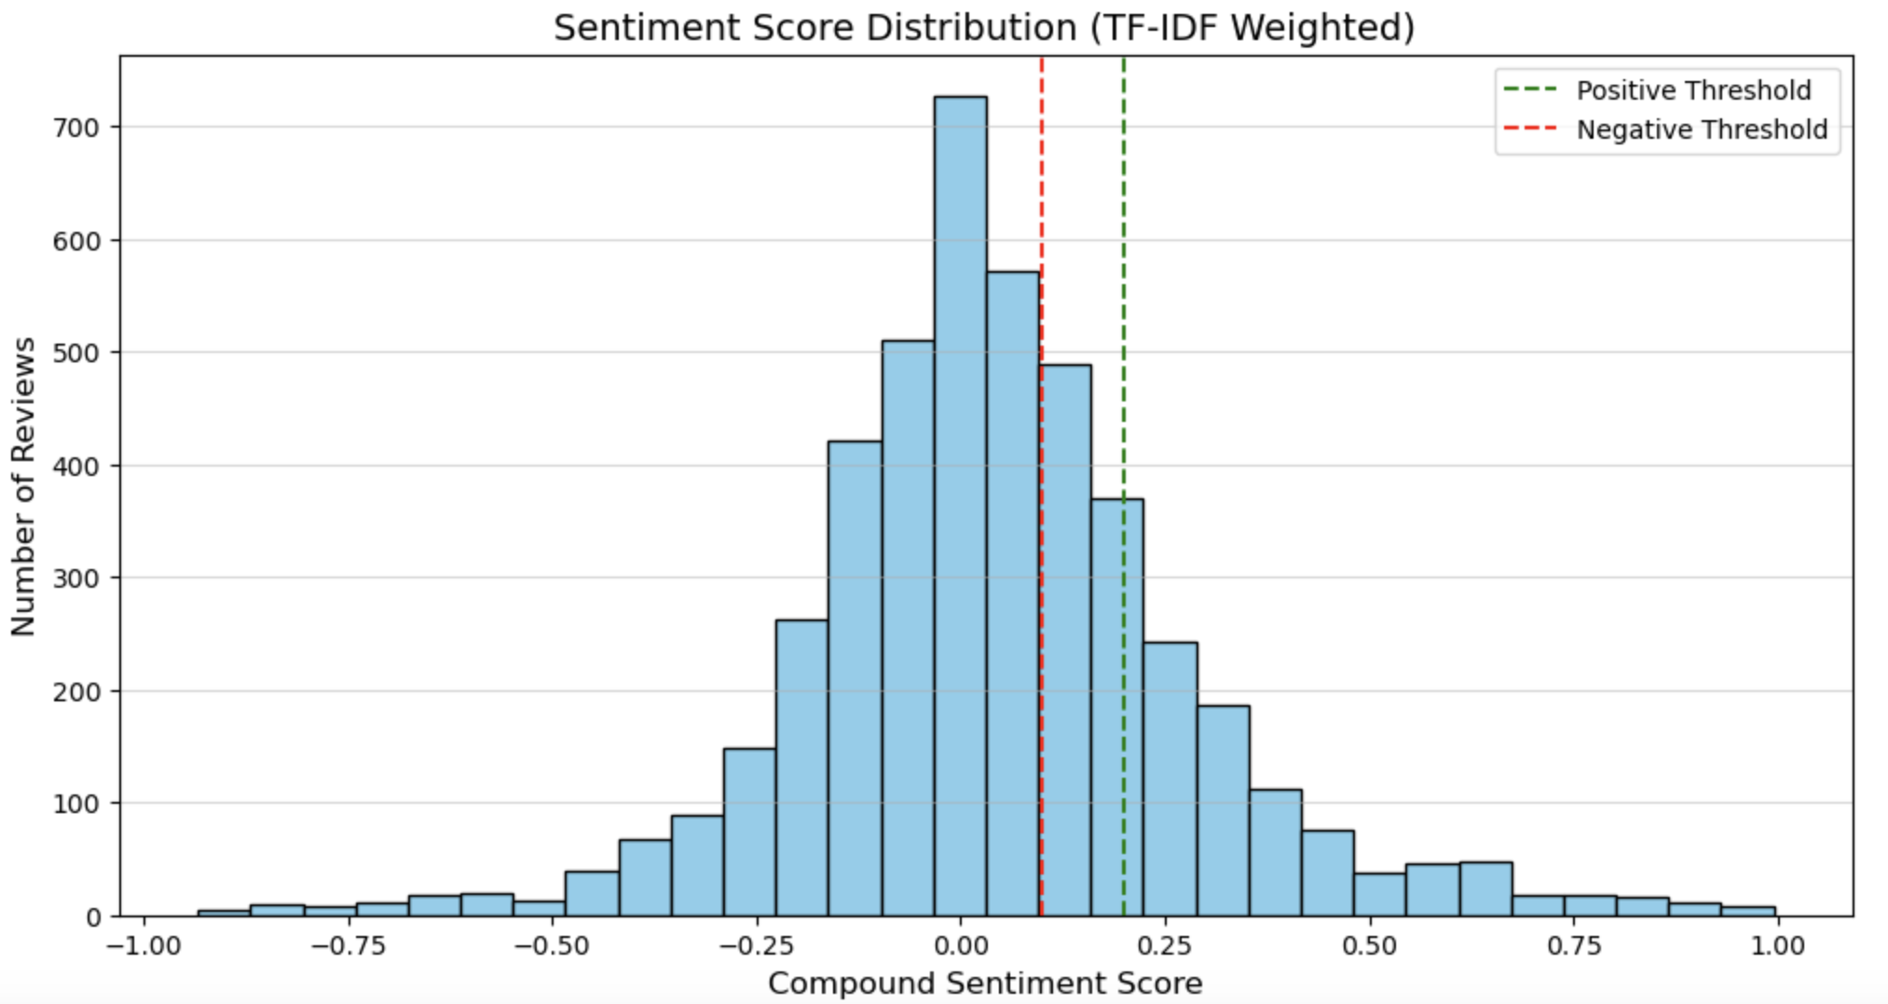
VADER Sentiment Analysis (cont.)
Sentiment Analysis
Sentence Tokenization
VADER sentiment analyzer: calculate the sentiment score of each sentence
TF-IDF weight: adjust the sentiment score of the sentence
Weighted Average Score: consider the weight of user star ratings (column: score)
Dynamic neutrality threshold system: consider the sample distribution

Slide 16
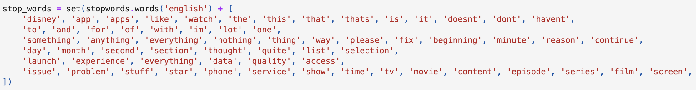
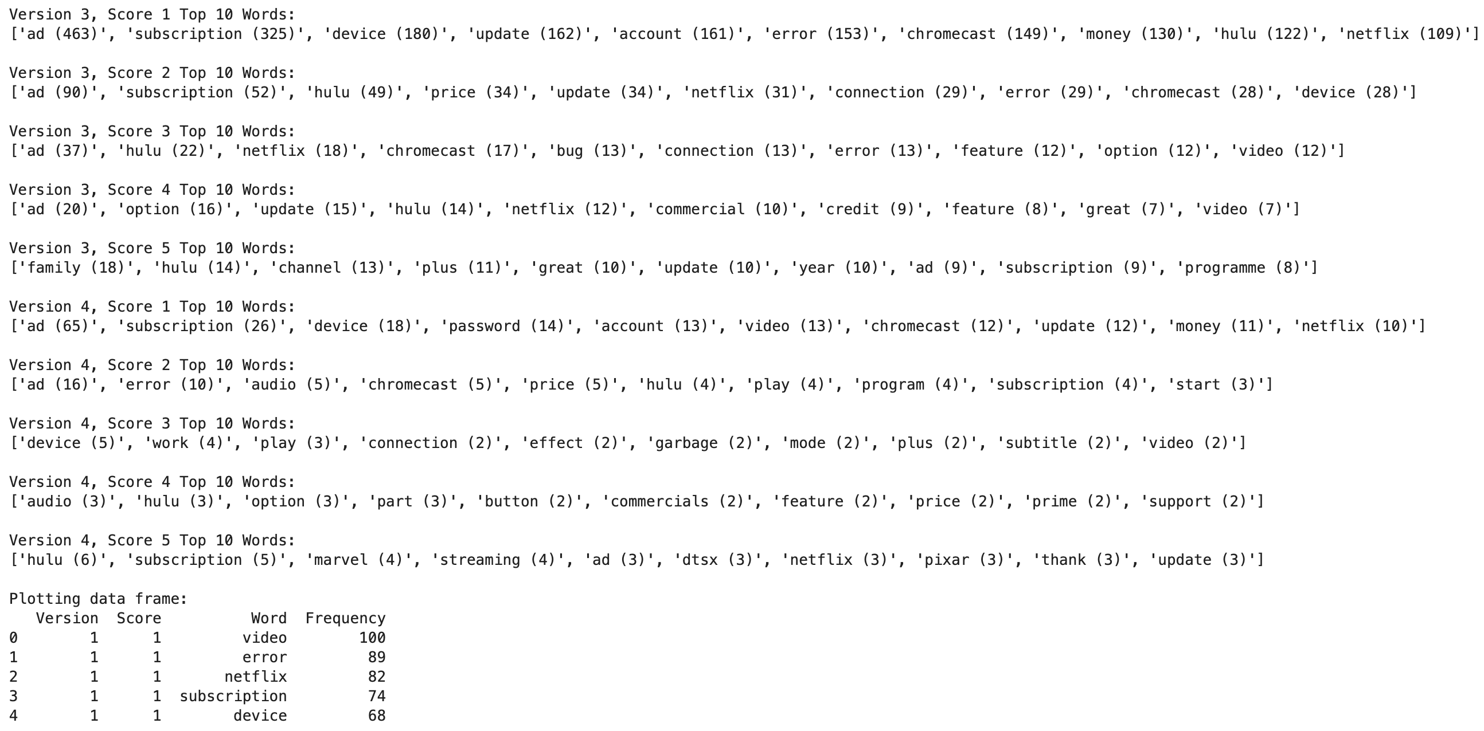
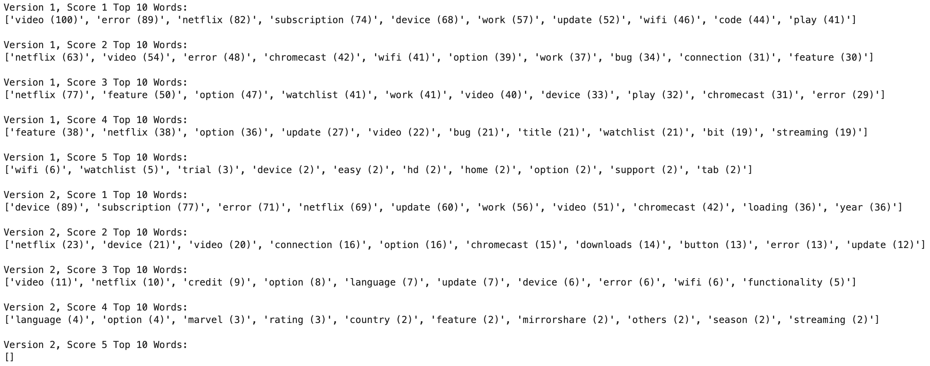
App Version Word Analysis
App version: According to the major version (first digit; version 1 to version 4)
Stop words:
remove words that lack analytical significance
the stop_words list needs to be updated several times by running the code and examining the results.
TOP 10 words with different scores in different versions:

Slide 17
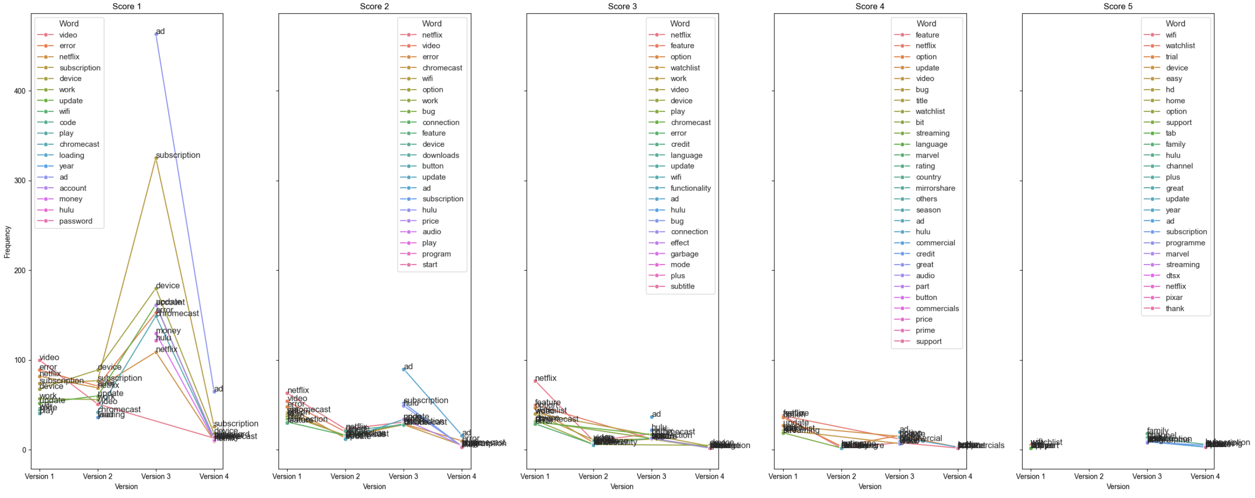
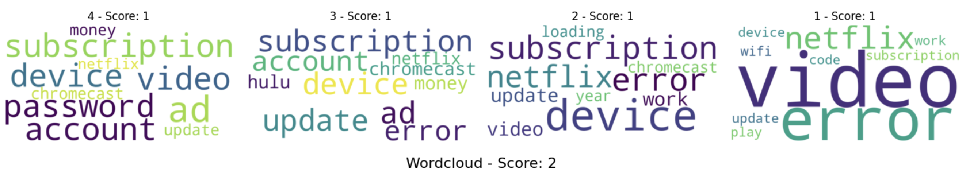
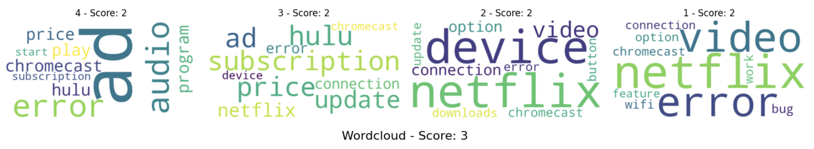
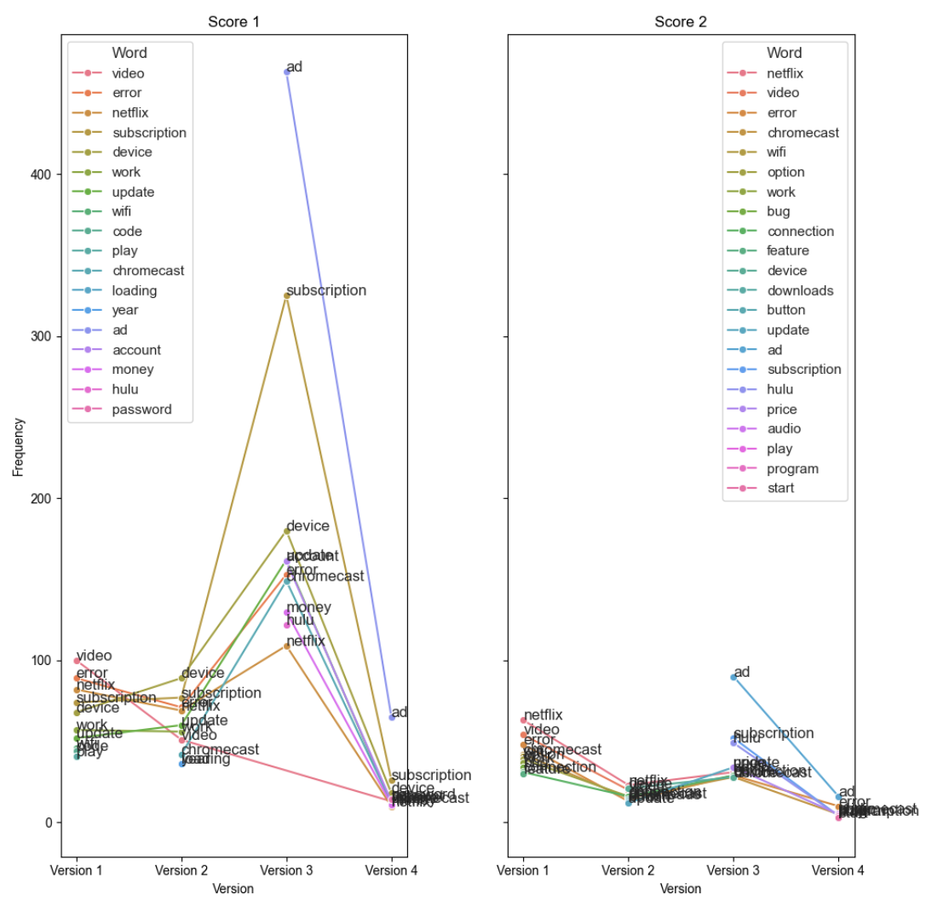
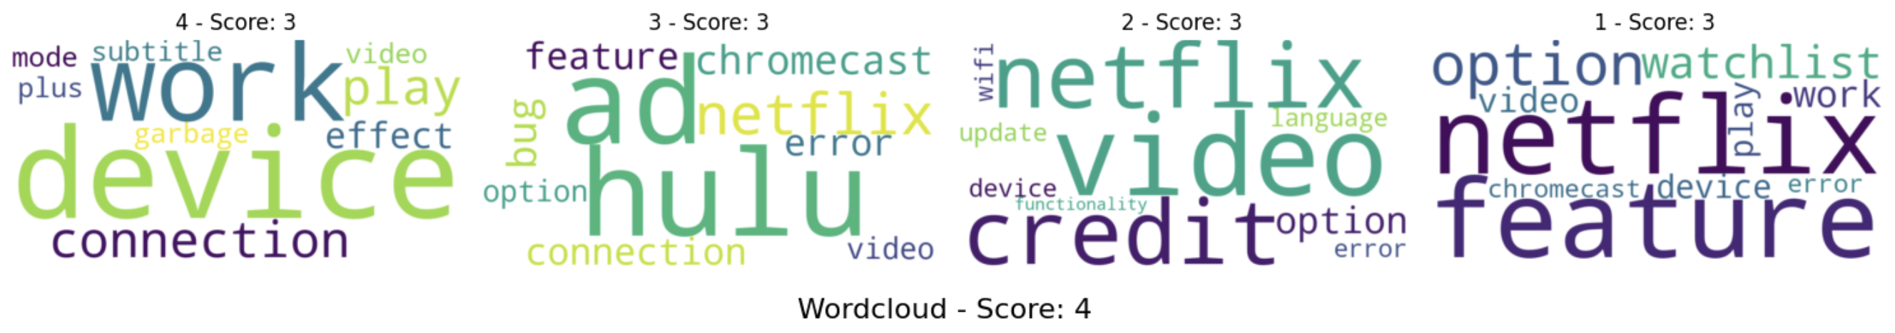
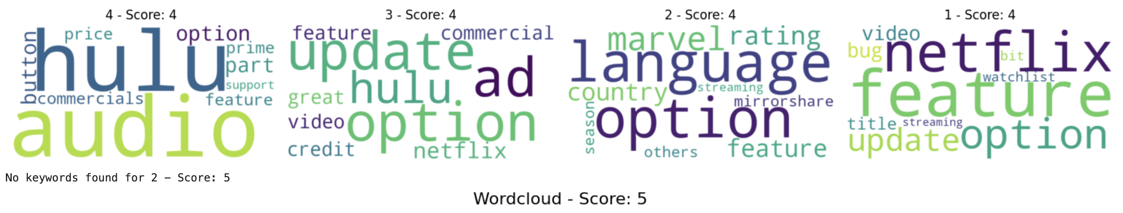
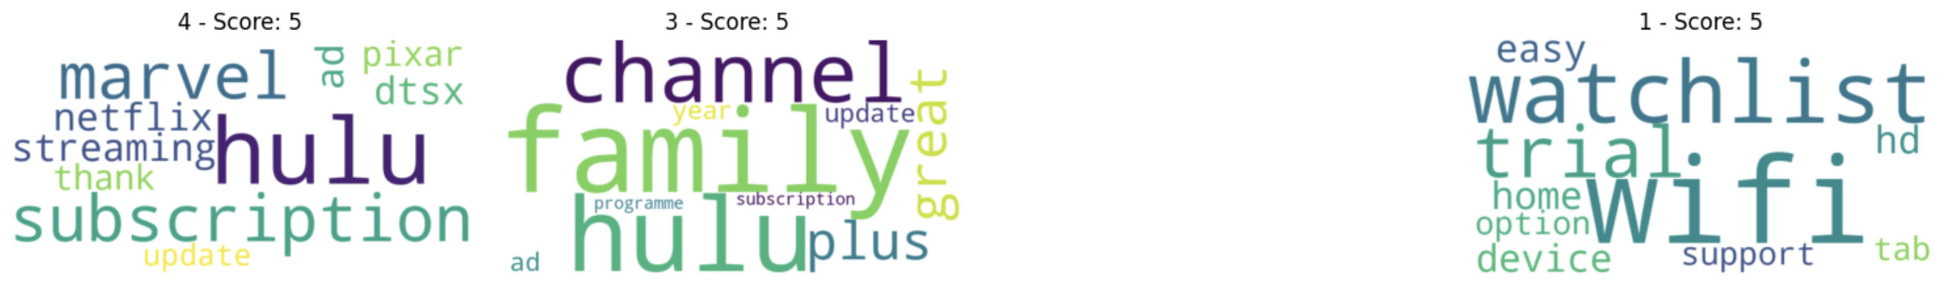
App Version Word Analysis (cont.)
TOP 10 words with different scores in different versions:
ad
ad

Slide 18
05
Emotion Analysis

Slide 19
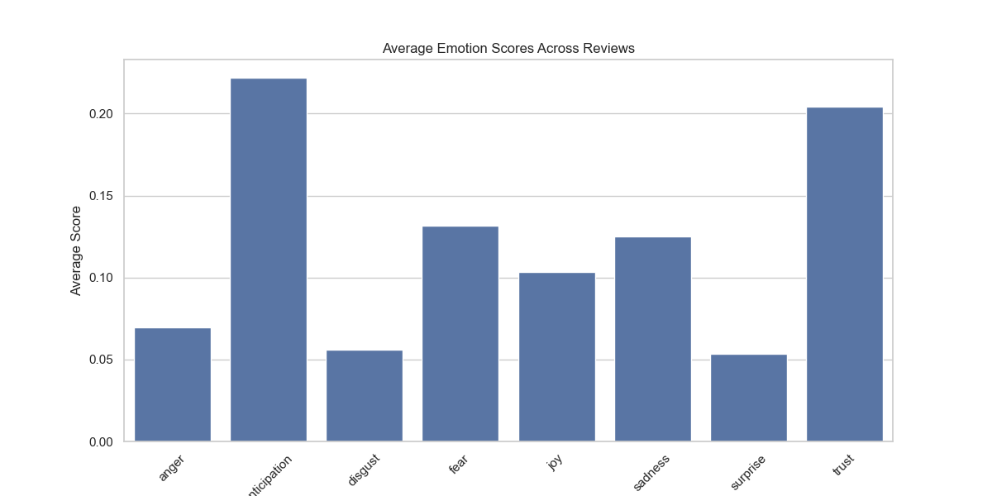
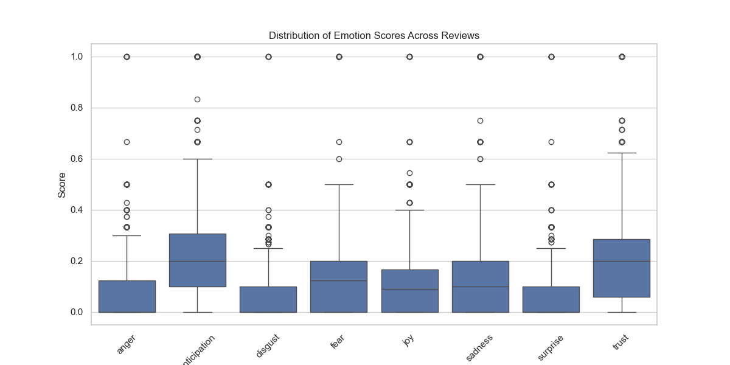
Emotion Analysis-NRC lexicon Analysis 1: Distribution
Similar method to process the negation words.
Read the NRC dictionary and perform emotion analysis based on the dictionary to obtain scores for eight emotions: ‘Anger', ‘Anticipation', ‘Disgust', ‘Fear', ‘Joy', ‘Sadness', ‘Surprise', ‘Trust'.

Slide 20
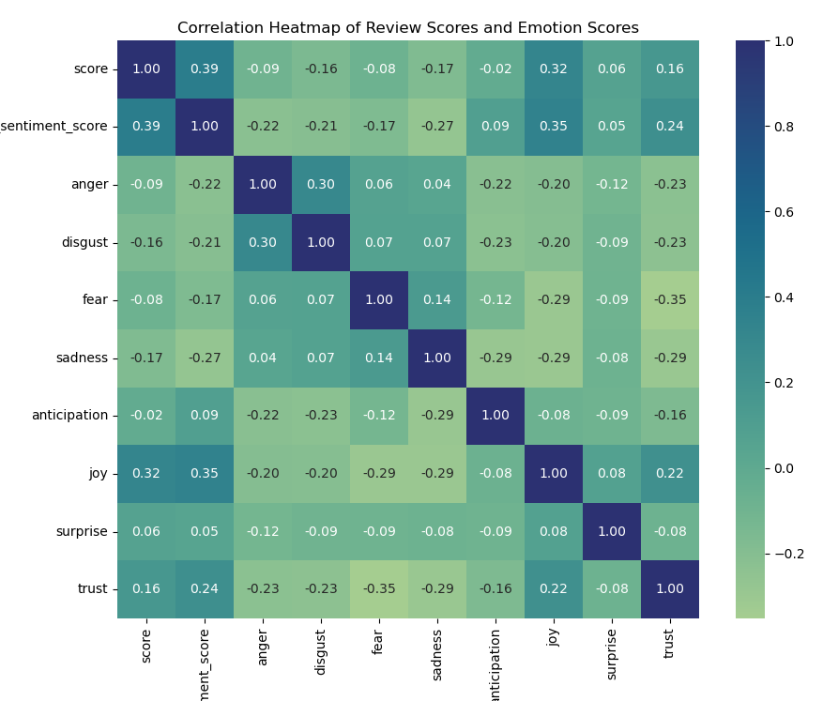
Emotion Analysis-NRC lexicon Analysis 2: Correlation
Calculate the correlation between each emotion score and the crawled user score.
Between each of the emotional scores and user score,
negative emotional tendencies are negatively correlated with score, while positive emotional tendencies such as are positively correlated with scores, which shows the consistency between emotional tendencies and scores.
Negative
Emotions
Between emotional dimensions,
1) negative emotions are relatively positively correlated;
2) negative emotions are relatively negatively correlated with positive emotions.
This shows that emotional tendencies are consistent with emotion scores.
Positive
Emotions

Slide 21
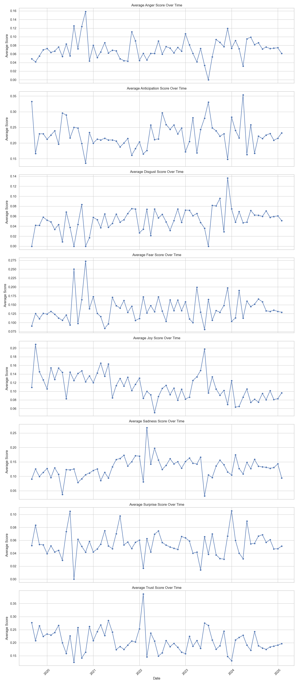
Emotion Analysis-NRC lexicon Analysis 3: Time-series
The average change of each of the 8 emotions for each month from 2020 to 2025 is recorded.
From the overall trend, some emotional indicators show similar change patterns, such as anger and disgust, joy and anticipation.
Some emotional indicators show co-changing patterns around specific time points. E.g., anger & disgust versus anticipation; surprise & sadness versus trust.

Slide 22
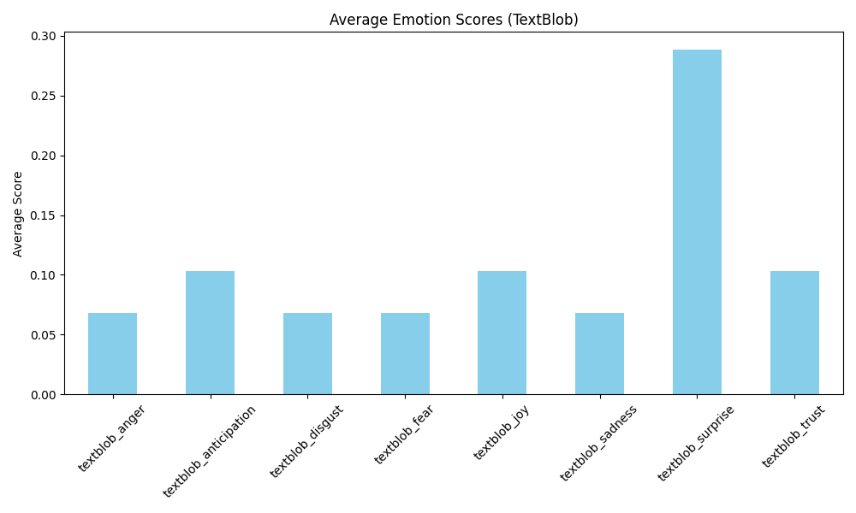
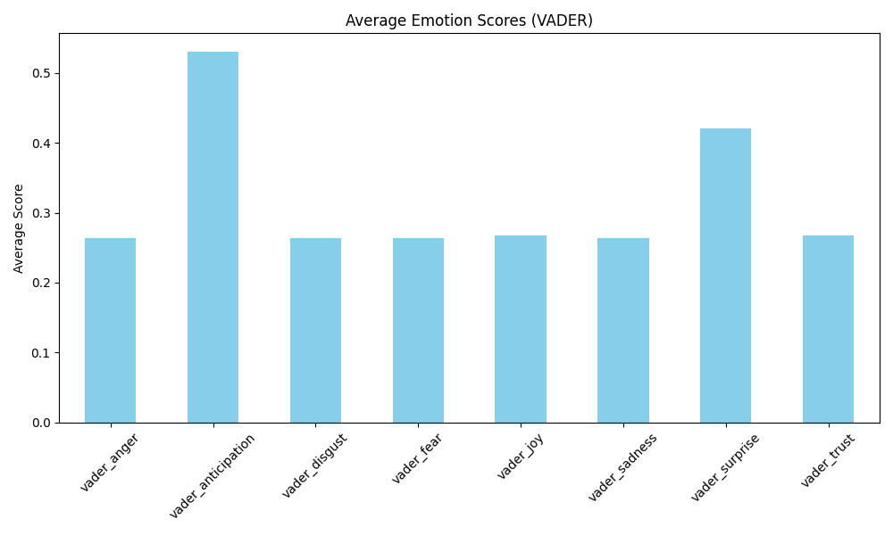
Emotion Analysis-Other Methods TextBlob, VADER
By reading the literature, we found that in addition to NLTK, there are other tools and programming libraries that can be used for sentiment analysis, such as TextBlob and VADER.
Therefore, we attempted to perform the analysis using these two methods as a comparison to the NRC.
Method comparison
Method | Advantages | Disadvantages
TextBlob | - Easy to use - Can analyze both polarity and subjectivity - Supports multiple languages | - Slightly lower accuracy compared to specialized tools - Unable to accurately identify certain nuanced emotions like surprise and anticipation
VADER | - Optimized for social media text - Can identify subtle emotions like surprise and anticipation - Higher accuracy in sentiment analysis | - Only supports English - Unable to analyze subjectivity
NRC | - Covers 8 basic emotions - Higher accuracy in sentiment analysis - Supports multiple languages | - Requires additional emotion lexicon resources - Struggles with complex semantics and negation

Slide 23
06
Clustering & KNN

Slide 24
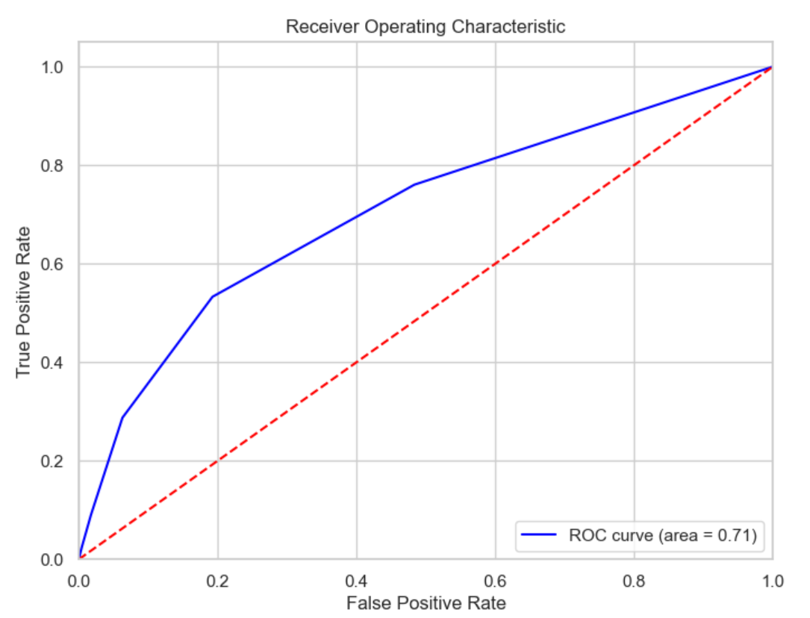
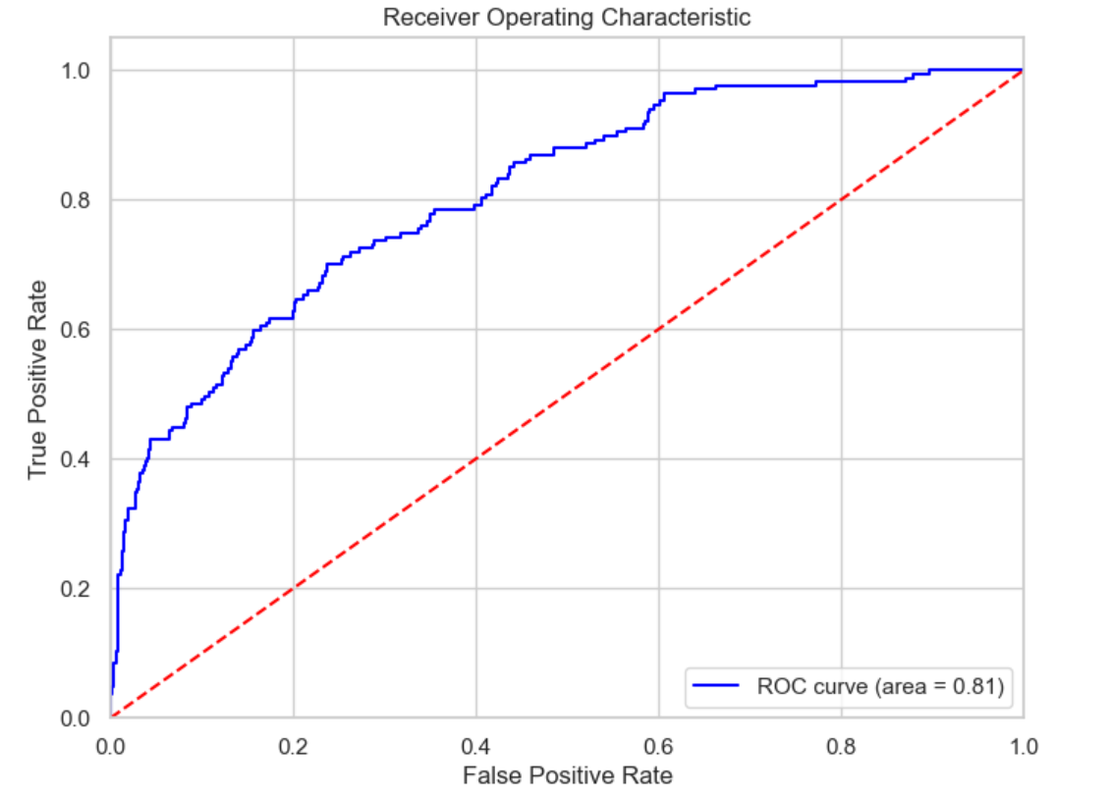
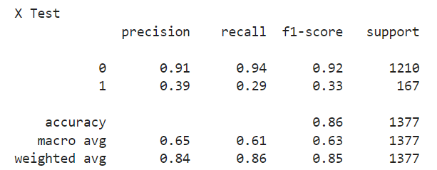
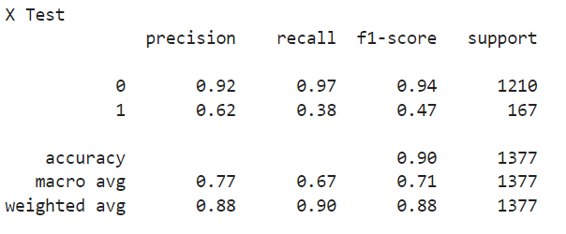
KNN/NLP Prediction
KNN
NLP
Here we have used three methods to train predictions on the dataset. So, and Neural Networks predicted correctly up to more than 86% and the quality of the dataset is also good.
So, in the subsequent use of Random Forest, we tended to think about the effect of some of the words on the dataset, i.e., the prediction of people's emotions when they score.

Slide 25
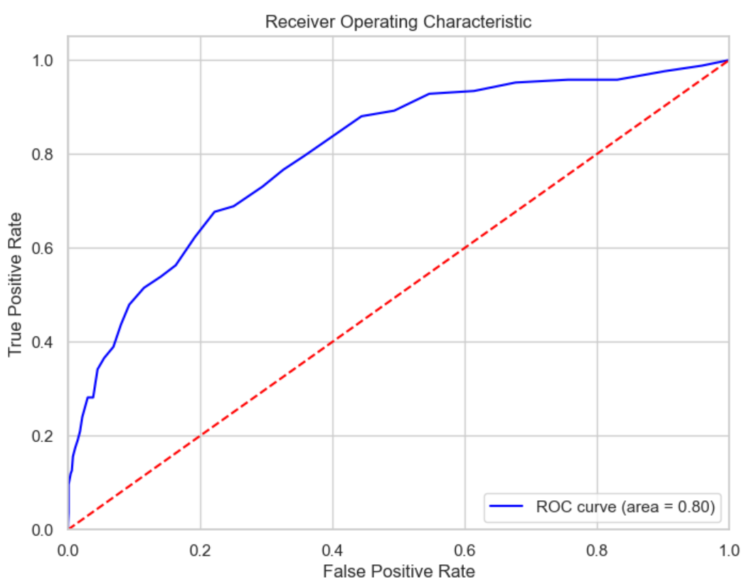
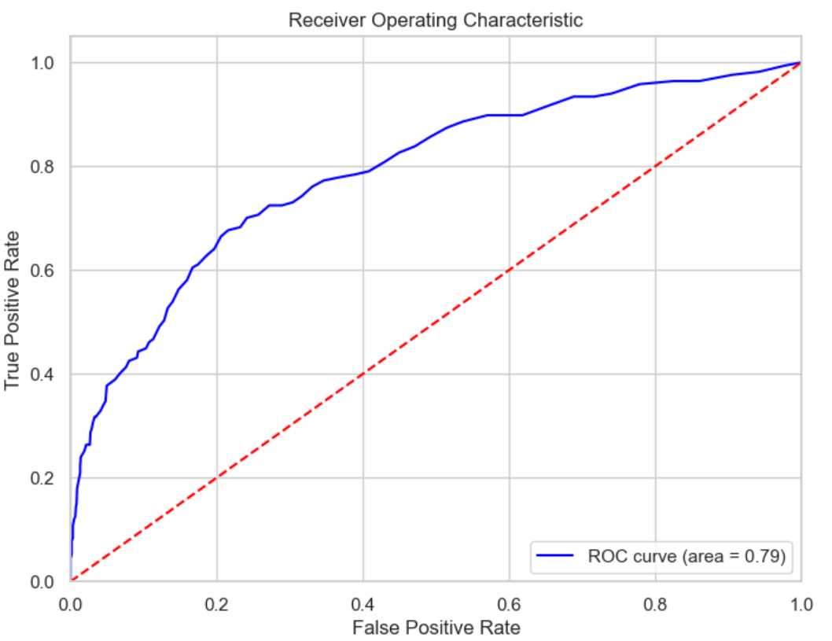
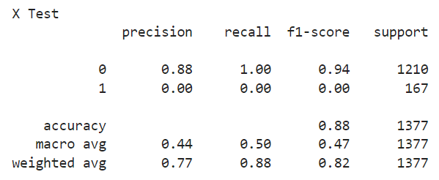
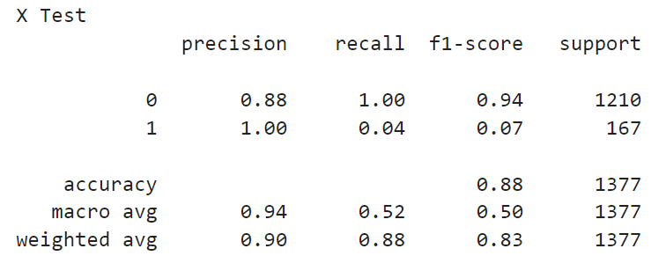
Random Forest Prediction
Although the improved Random Forest predictions are no different from the original, observing the detailed data, we can see that the direct use of Random Forest completely fails to identify the positive class, and the improved recognition rate of the positive class is also very low.
This also suggests that the predominance of negative comments in our dataset led to an imbalance in training.

Slide 26
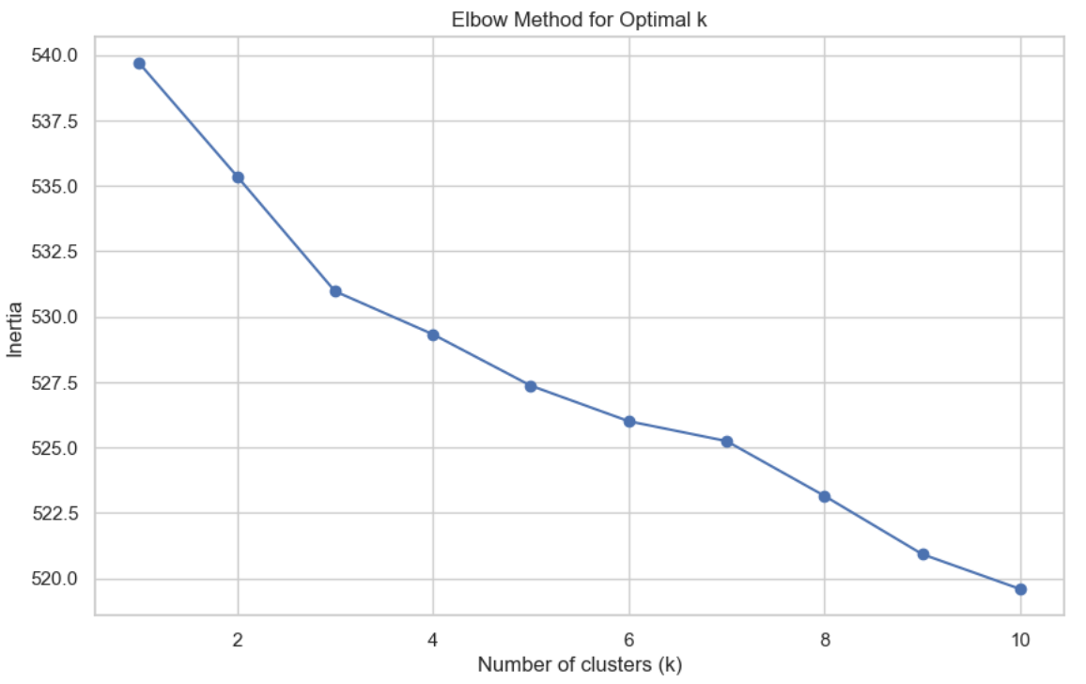
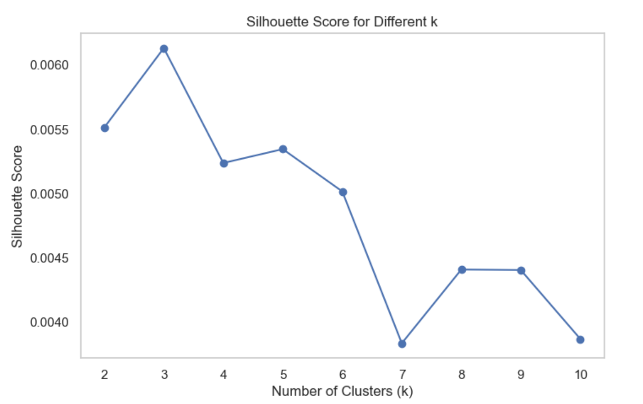




Clustering
Positive
Score>3
The more the number of clusters, the more computationally intensive it is, the model is more prone to overfitting, and the features of the clusters become blurred.
So, using cross-validation, we determined the number of clusters for positive and negative comments.
Negative
Score<4
Ultimately, we determined that the number of clusters for positive comments was six, while the number of clusters for negative comments was eight.

Slide 27




Clustering--positive
Surprisingly, although the mean scores of the clusters all exceeded 4, only two clusters had positive sentiment analyses.
The app offers all the beloved Disney shows and movies, the content of which is great for families, and although some of the new seasons are slow to update, the overall experience feels good.
The app is missing the catalogue system, which alphabetically sorts the shows poorly, making for a smooth viewing experience; and updates tend to cause the app to fail to open.

Slide 28






LDA--Positive
Through consistency analyses, we determined that the optimal number of themes for positive evaluation was three.
We were more interested in knowing the focus of the reviews of the different versions, so we conducted an LDA analysis of the four versions:
1. version 1: content requirements, viewing experience and potential problems.
2. Version 2: video playback smoothness, content usability and user experience.
3. Version 3: the emotional value embodied in videos such as films and programs and the services provided by the app.
4. Version 4: the discussion of film and television content, including the app's video recommendations, viewing experience and customer service quality.
.

Slide 29


Cluster--Negative
Negative reviews do not appear to be positive, suggesting that when the rating is less than 4, users have a negative attitude.
And after using the same summary approach, it was found that users were more strongly dissatisfied with the following points:
Technical issues: the app is often unresponsive, black screens, and especially performs poorly on certain specific devices (e.g. Lenovo tablets and Samsung devices).
Ad experience: Users expressed strong dissatisfaction with the frequent insertion of adverts and felt that the viewing experience was severely affected.
Lack of offline functionality: Users were unable to use the app while offline or abroad and felt this was a major flaw.
Inadequate customer support: Users have not resolved the issue after speaking with customer support.

Slide 30





LDA--Negative
We find that users are also more dissatisfied with paying for subscriptions, and the viewing experience of videos, especially paid films.
Here, we compare the user topic feature words of positive comments and many who scored low were more likely to describe their requirements and preferences for personalized settings and that the placement of advertisements caused many users to be dissatisfied.
.

Slide 31
07
Conclusion
1. Key Findings
2. Business Recommendations
3. Future research directions

Slide 32
Key Findings
User Sentiment Evolution：Contrary to H1, Disney+ ratings declined steadily from 2.5 stars at launch (2019) to approximately 1.5 stars (2022-2023). This downward trend persisted across all major version updates, with no version successfully reversing user dissatisfaction.
Finding 1
Negative Review Drivers：Supporting H2, technical issues dominate negative feedback, including app unresponsiveness, streaming problems, and device compatibility issues. Additional key complaints include intrusive advertising, lack of offline functionality, poor customer support, and subscription payment concerns.
Finding 2
ML Prediction Effectiveness：Confirming H3, our models predicted user satisfaction with high accuracy. Neural Networks achieved over 86% accuracy, with KNN and NLP approaches also performing well. The dataset's negative review imbalance created challenges for Random Forest models in identifying positive classes.
Finding 3
Emotions and Ratings Correlation：Supporting H4, emotion analysis revealed strong correlations between emotional content and ratings. Negative emotions (anger, disgust, fear, sadness) consistently correspond with lower ratings, while positive emotions (joy, anticipation, trust) align with higher ratings. The sentiment score showed a 0.39 correlation with user ratings.
Finding 4

Slide 33
Business Recommendations
Prioritize Technical Stability
Address the critical technical issues driving negative sentiment by establishing a dedicated team focused on resolving device compatibility problems, particularly for Samsung and Lenovo devices. Implement more rigorous quality assurance testing before releasing updates.
Revise Advertising Strategy
Reconsider the current advertising approach that significantly impacts user satisfaction. Implement less intrusive ad placements and offer enhanced ad-free subscription options that better align with user expectations.
Enhance Offline Functionality
Expand offline viewing capabilities to address a top user pain point identified in sentiment analysis.
Transform Customer Support
Implement a more comprehensive response strategy with faster resolution times, focusing particularly on the technical issues and content accessibility concerns identified in the clustering analysis.

Slide 34
Future research directions
Competitive Benchmarking Analysis
Compare user sentiment patterns with Netflix, HBO Max, and Amazon Prime to identify industry best practices that could improve Disney+'s performance and establish realistic targets for technical stability and customer satisfaction.
Feature Impact Evaluation
Measure the specific impact of individual features (offline viewing, ad frequency, UI changes) on user satisfaction through controlled studies to prioritize development resources based on quantifiable user experience improvements.
Retention-Sentiment Correlation
Analyze the relationship between negative sentiment patterns and subscription cancellations to identify which specific issues most directly contribute to churn versus temporary dissatisfaction.

Slide 35

Thanks !

